Slide 1


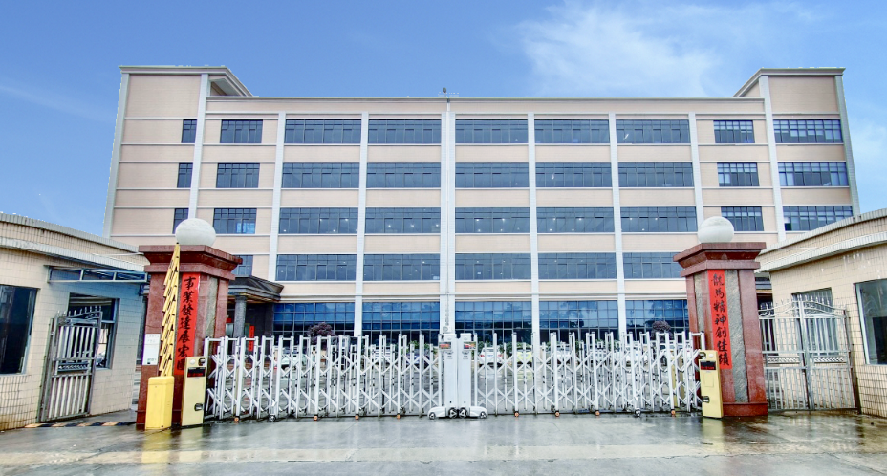
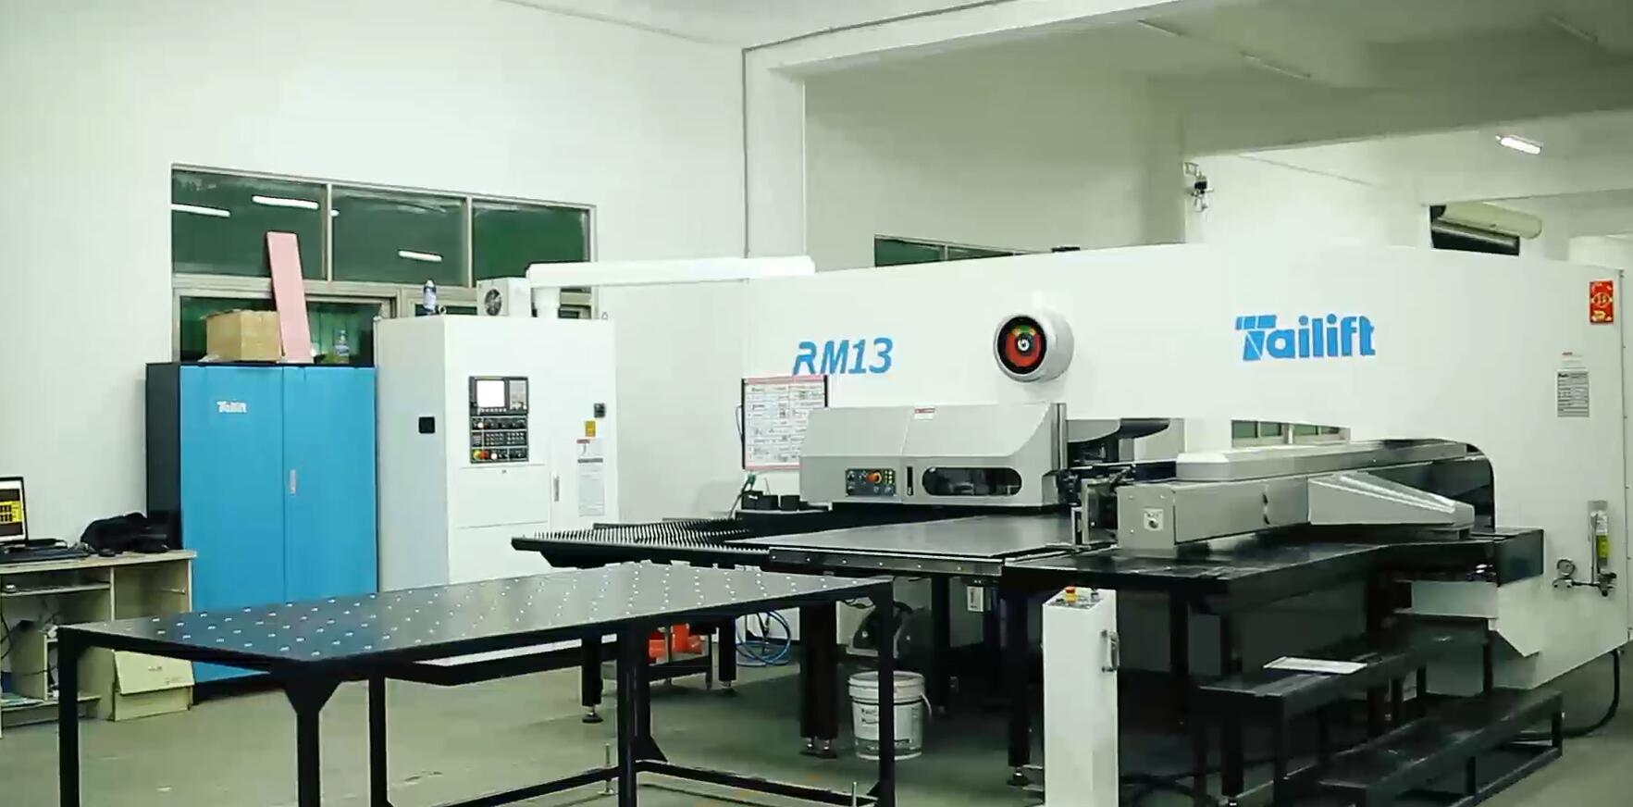
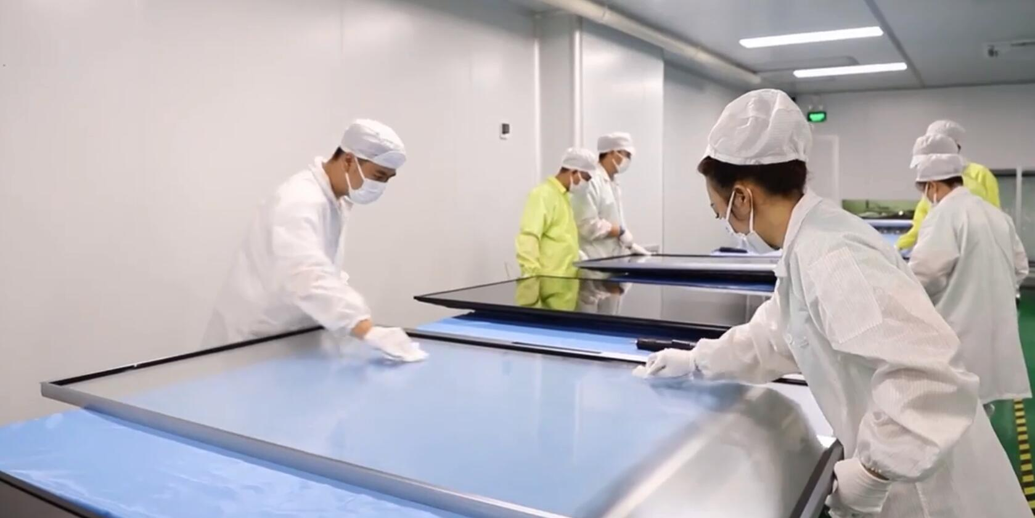
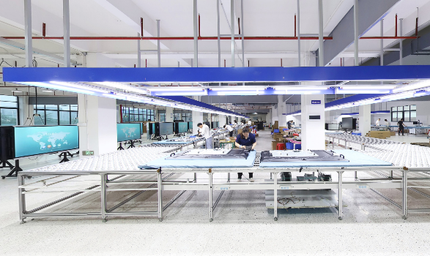
Shenzhen Fangcheng Tech Co., Ltd. founded in 2009, headquartered in Shenzhen, factory in Huizhou is a high-tech enterprise specializing in R &D, production and sales of multimedia education equipment.
Since its establishment, FangCheng has won the "China's top 10 Influential Teaching Industry brand" award, has acquired CE, ROHS, FCC,CB, ISO9001, ISO14001 certificates.
With strong R&D team and multiple production lines, We own hardware patents and software copy rights. Products have been exported to more than 100 countries and areas through its distributors, agents and OEM&ODM partners worldwide, and have been unanimously recognized by users.

Slide 2
Solution for SKD
of Interactive Flat Panel
1.Lower tariff Provide
2.To recue failure rate (Modularization)
3.Low requirement for environment ( no need of dust free workshops)
4.Low technical requirement

Slide 3
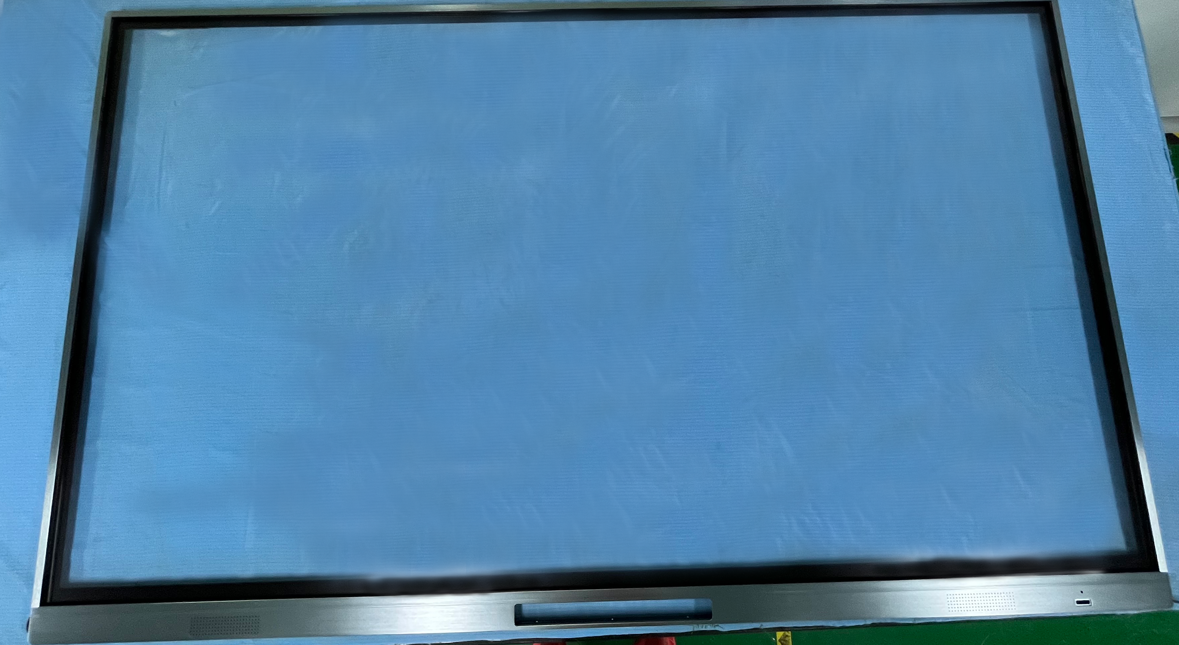
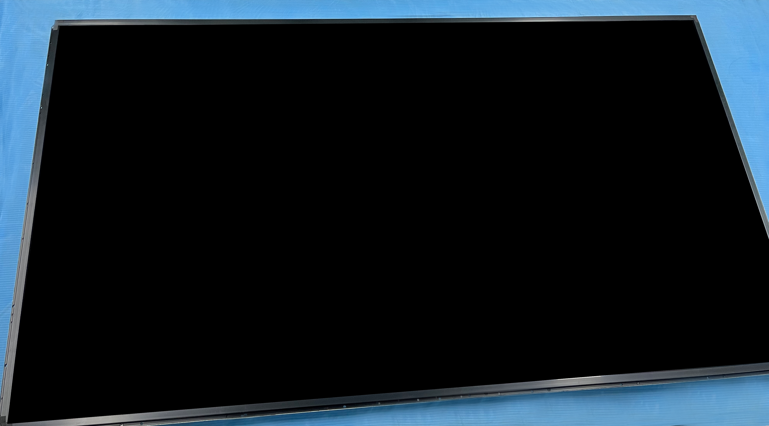
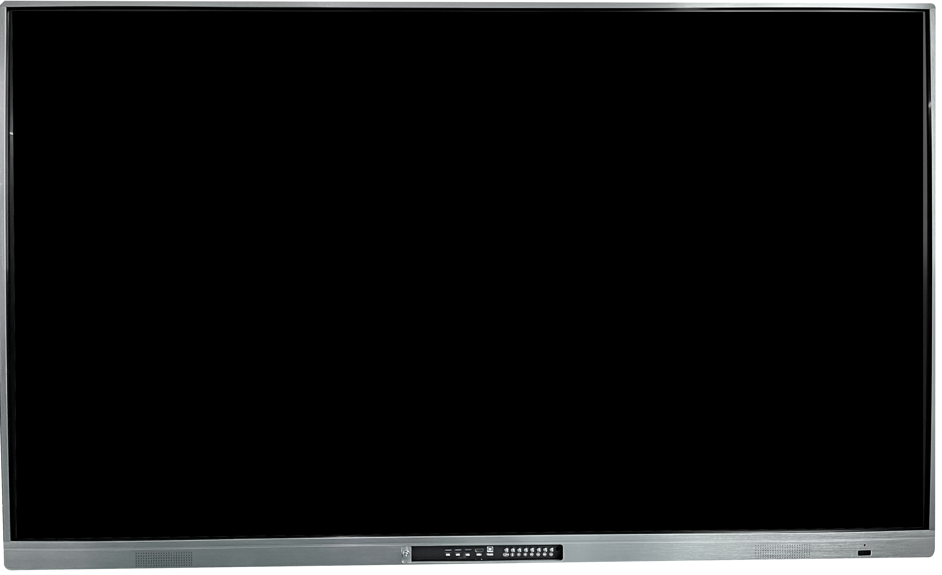
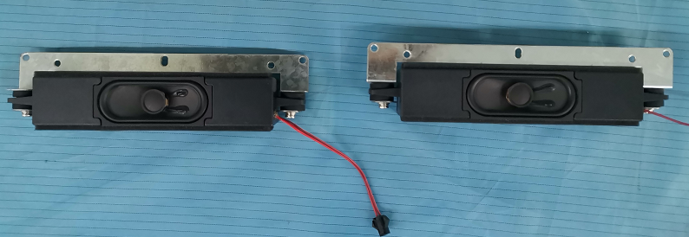
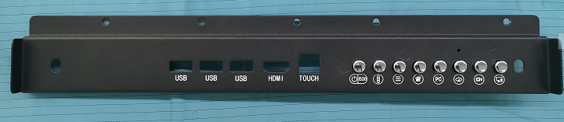
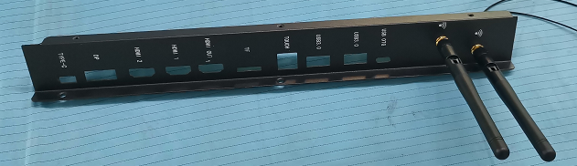
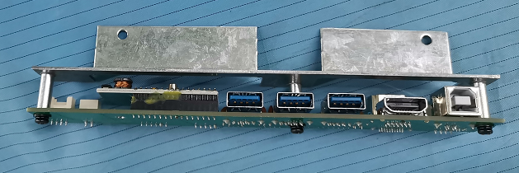
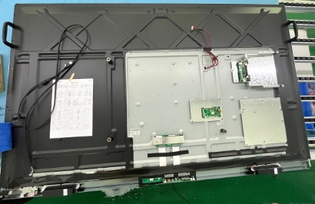
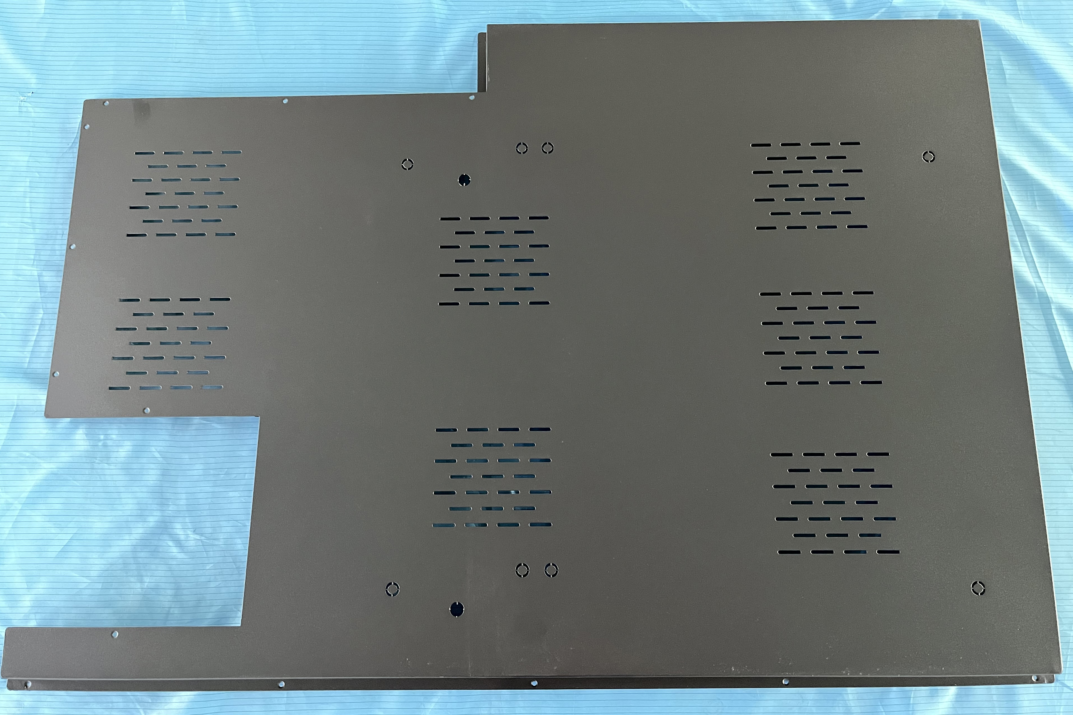
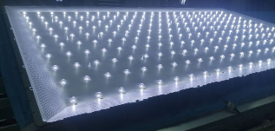
Backlight with OC module and touch frame
1.Tempered glass front cover
2. LCD Screen
include
3. Audio
4. Interface cover
5.Back interface cover
6. Front interface
7. Back shell
8. Backlight

Slide 4
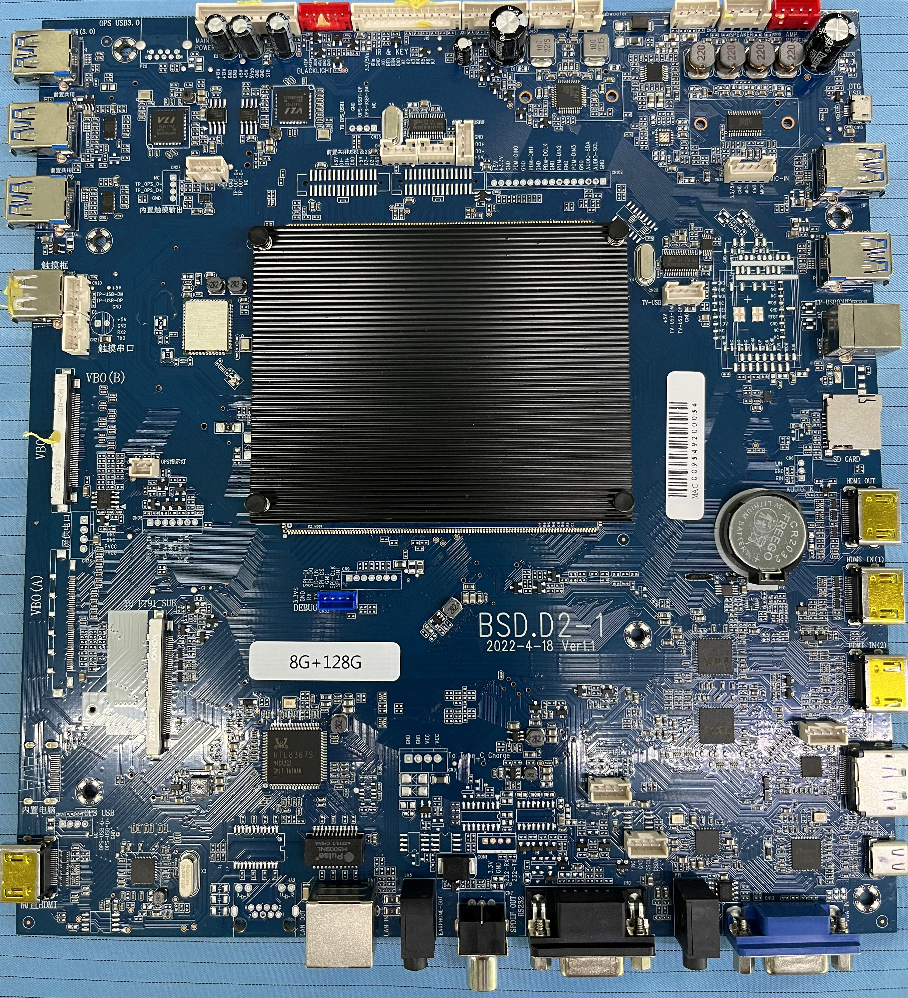
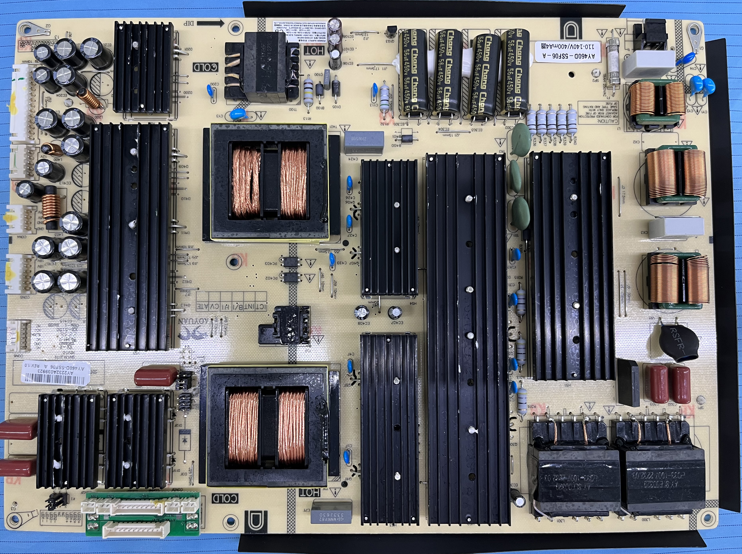
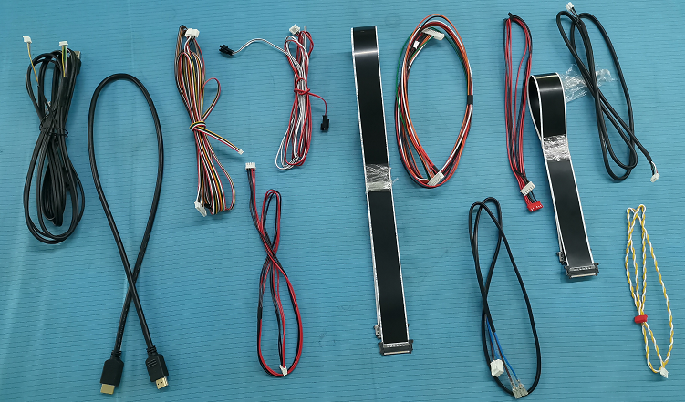
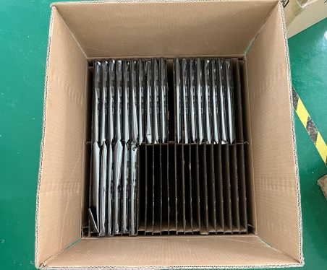
Components are delivered separately
Motherboard
The power supply board
Cable
Packaging box

Slide 5
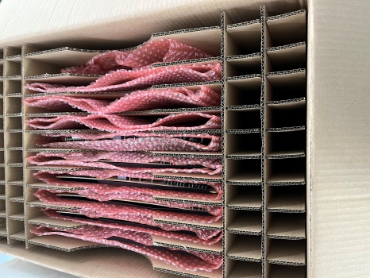

Manner of packing components
Power board with bubble pack+Carton box
Android board with antistatic bag+Carton box
Components are delivered separately
Carton Box and Protective foam

Slide 6
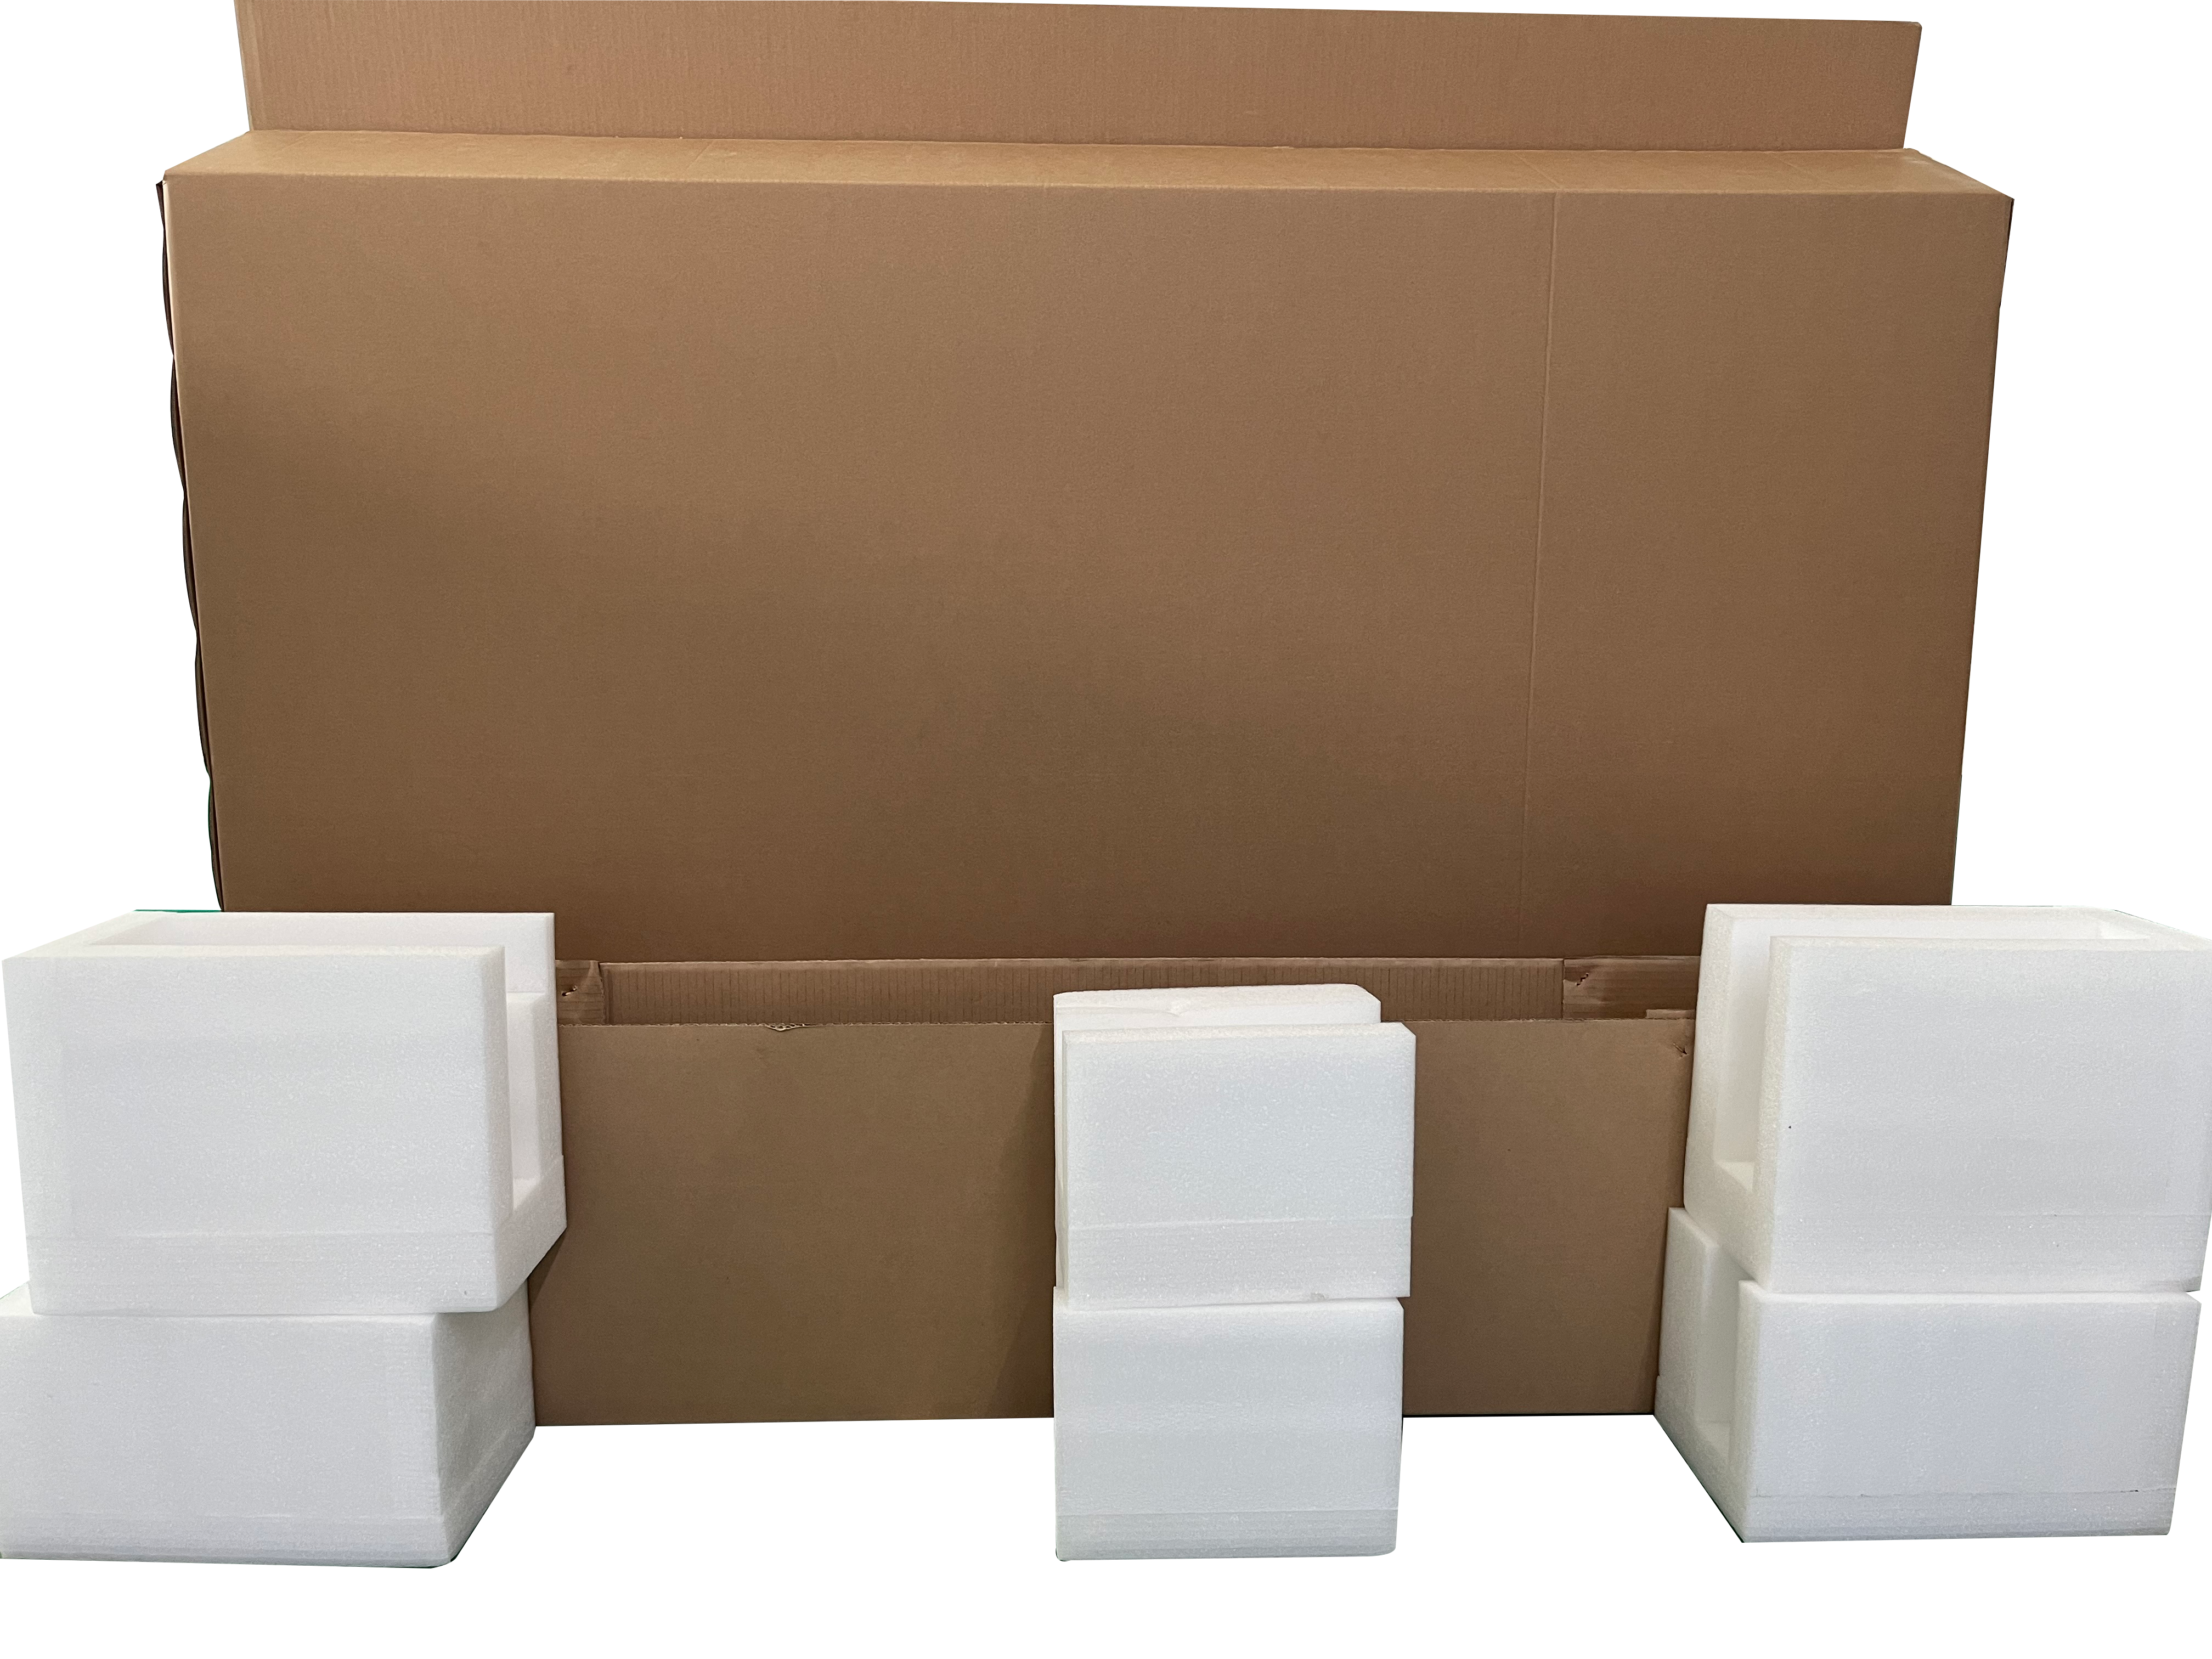
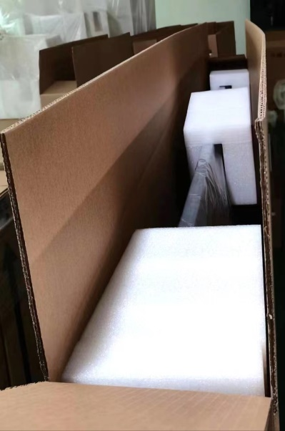
Finished product packing box
Why we choose this kind of packing for LED module?
Reason one: Increase the usage of shipping container
space.
Reason two: Customers can pack the goods directly
in this carton after assembly.
Carton Box and Protective foam

Slide 7
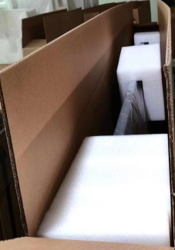
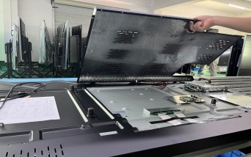
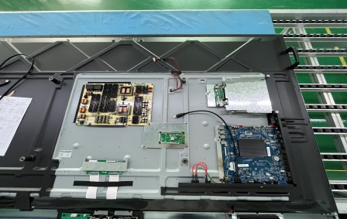
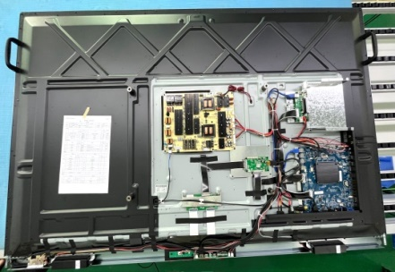
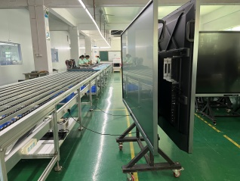
The flow chart
1.Open the back cover
2. Fix the computer, motherboard, power board (Will provide detailed work instructions））l be made after placing the order)
3. Wiring (Detailed work instructions will be made after placing the order)
4. Testing
5.The finished product

Slide 8
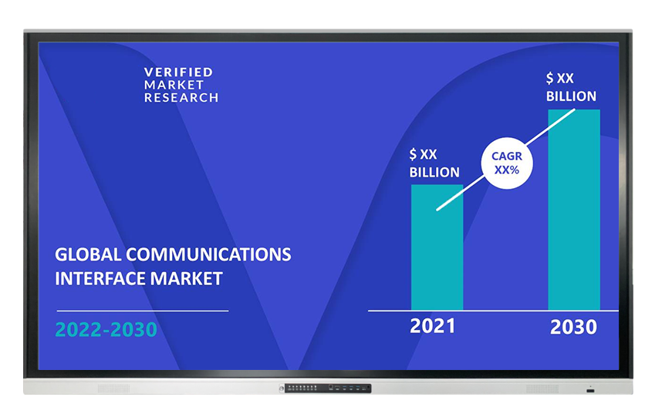
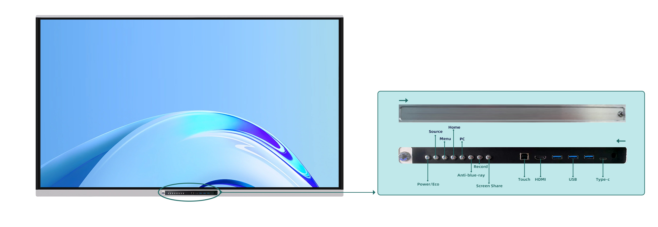
Our advantages
1. Unique design - Sliding lock for protection
2. Stable Quality:
* Screen material : Orignal A grade
* Low after-sales rate:
-screen material : <0.5%
3. R&D and Technical Support
NEW TECHNOLORY：Glass Bonding
Writing experience: zero-gap writing, faster response and Windows support 50 points touch
4.Upgrade brightness: 65inch>380~400cd2,75~98inch≥450cd2,backlight life ≥50,000hours
5. Free Educational Software Provided
Rich teaching resources

Slide 9

THANK YOU!

